Slide 1

Alaska Air
Kerri McMahon - Wyatt Montana
COM 390 - Capstone

Slide 2
Important Project Information - An Overview
Flight - Alaska 205 - EWR (Newark, NJ) to LAX (Los Angeles, CA)
Languages/Tools used:
Client side - Visual Basic
Server side - PL/SQL
Multiple Regression Analysis - PL/SQL
Data Visualization - R, scatterplot3d and ggplot2 libraries
Database Design - LucidChart

Slide 3
Dynamic Pricing - What Exactly is Going On?
Simply put, dynamic pricing is a strategy in which product prices continuously adjust, sometimes in a matter of minutes, in response to real-time supply and demand. Programmatically, software considers real-time factors to optimize the price for a product or service with consideration of several factors or “variables”.
As per Michael D. Wittman & Peter P. Belobaba article, there seems to be slight variations in the fundamental concept of dynamic pricing.
Some experts describe it as ‘‘the dynamic calculation of the optimal price, taking into account the airline’s strategy, customer-specific information, and real-time alternative offerings,’’ while others define it as ‘‘varying pricing over a continuous interval instead of opening and closing fare classes.’’
Under the latter definition, dynamic pricing would not be possible using traditional airline distribution technologies, which transmit and display the availability of a small number of pre-priced fare products.
It is still relatively new and evolving. It was only introduced into the airline industry in the 1980s.

Slide 4
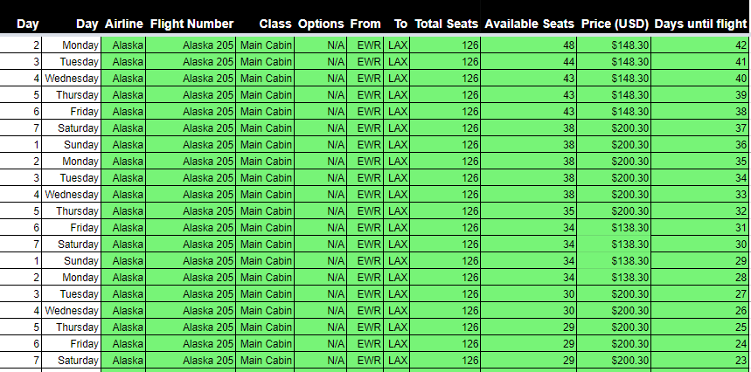
Alaska Air - Our Data & Analysis
Alaska Pricing Data Table Form
Three influential variables
Days Until flight
Available seats
Day of the week
We noticed pricing “blocks” - Price would not change every day, but would stay the same for a certain amount of days and change.
Price block changed 4 times on a Wednesday, 4 times on a Monday, 2 times on a Tuesday - However, the block sizes were not consistent enough to incorporate as a law in our equation
Price also went up substantially on Halloween (Four days until flight)
Screenshots of pricing chnages on certain days?
Notes:
** Also discuss price minimum.

Slide 5
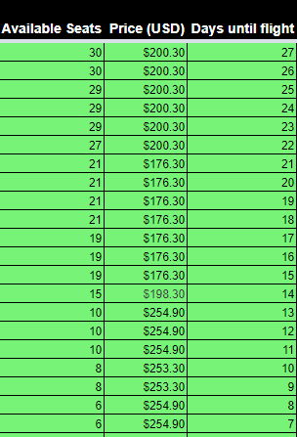
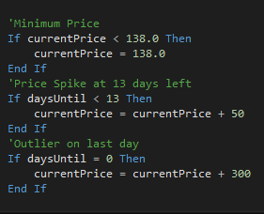
Unique-to-our-data Pricing Rules
Our ticket price never dropped below $138.00
We noticed a sudden price spike when the flight was within two weeks until departure.
We had an outlier of $794.90 on last day.

Slide 6
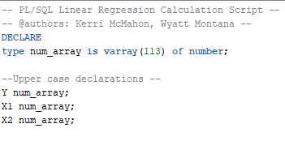
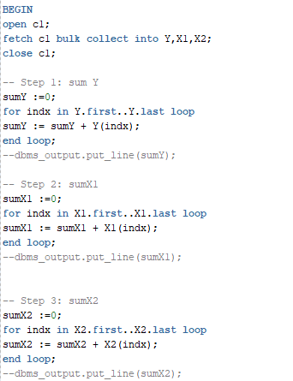
Regression Analysis
How - PL/SQL with imported data from Excel
General Flow -
Initialized an array num_array of type varray with length 113 (Amount of days of data taken+1, to be safe)
Implemented an explicit cursor to collect seat_price, days_till_flight and seats_available variables
Declared three num_array and called them Y,X1,X2.
Bulk collected appropriate data columns (Price, Days until Flight, Number of Seats) into arrays
Calculated initial summations using for loops
**SCREENSHOTS***

Slide 7
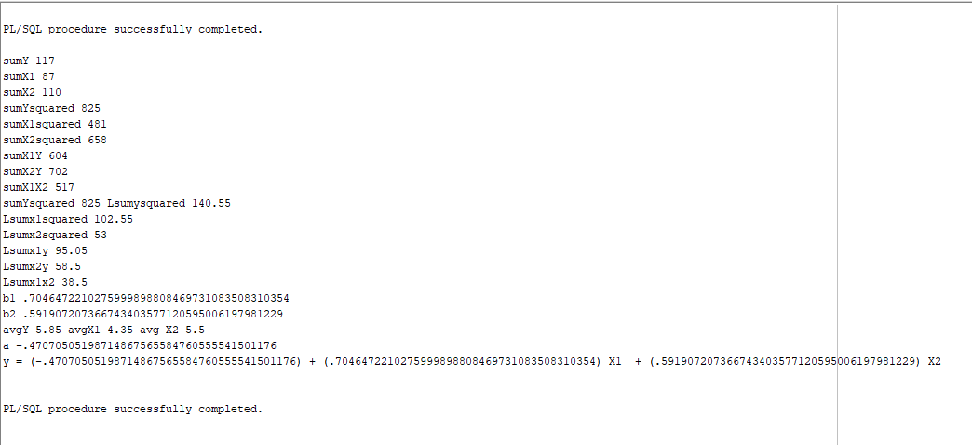

Our regression script output on our sample data set:

Slide 8
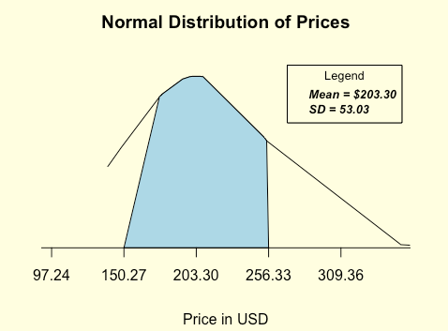
Normal Distribution of Price
Note that we had price “blocks” - so our scatter points were clustered together
Shaded area represents area of the curve that falls above or below within one standard deviation
Plotted in R

Slide 9
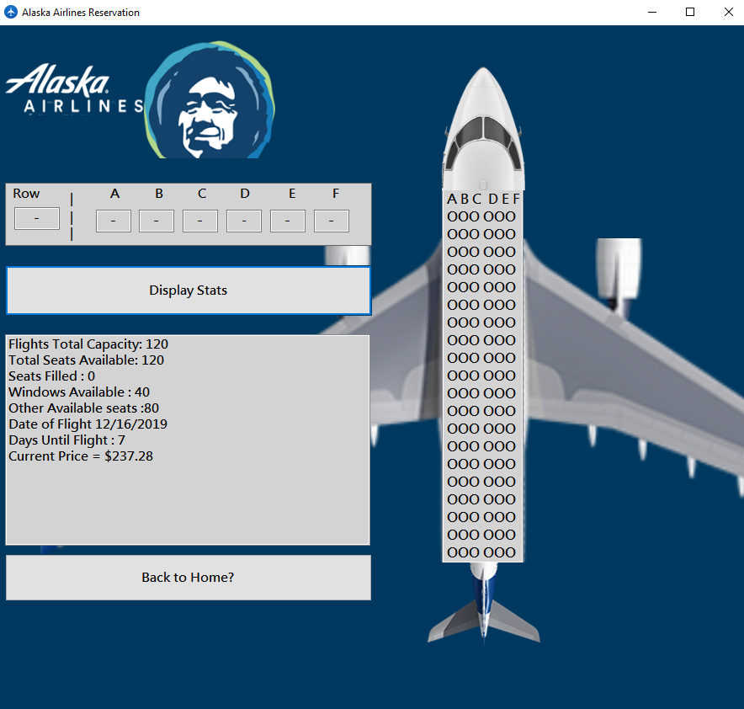
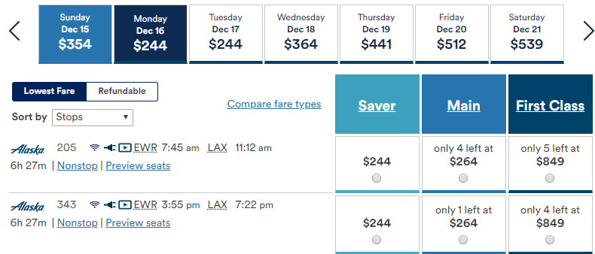
Real time data comparison

Slide 10
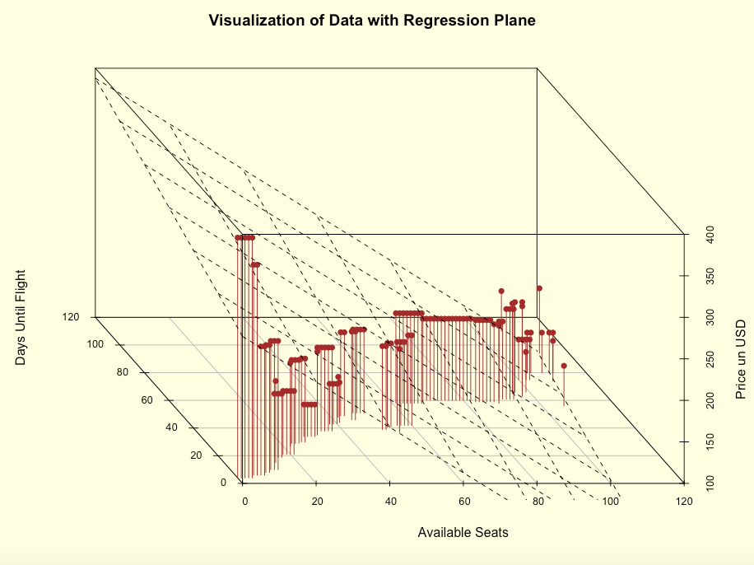
Data Visualization
Represents price in USD in relation to days until flight and number of seats available.
Note:
With multiple linear regression analysis, we must represent data in 3 dimensions due to there existing a z variable (price) that is dependent on two independent variables (available seats, days until flight)
This visualization does not consider our one outlier ($794.90 the day of the flight) for visual purposes.

Slide 12
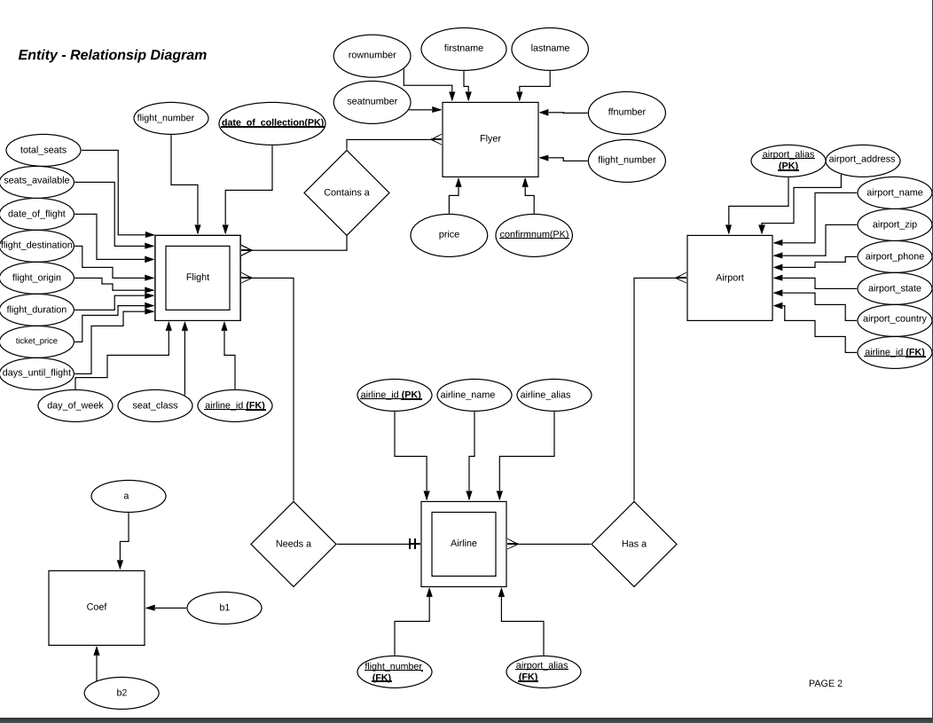
Our ER Model
Designed in LucidChart

Slide 13
Client Side (VB) vs. Server Side (PL/SQL)
User chooses date of flight
User chooses seat (row number and lettered seat)
User fills out customer information
Price calculation
Total seats calculation
Remaining seats calculation
Option for receipt retrieval vs. booking a flight
Procedures for inserting a flyer
Displaying reservation information, and selecting coefficients
Linear regression coefficient calculation (PL/SQL Script)
Confirmation number generation
Retrieval of seat purchase information

Slide 14
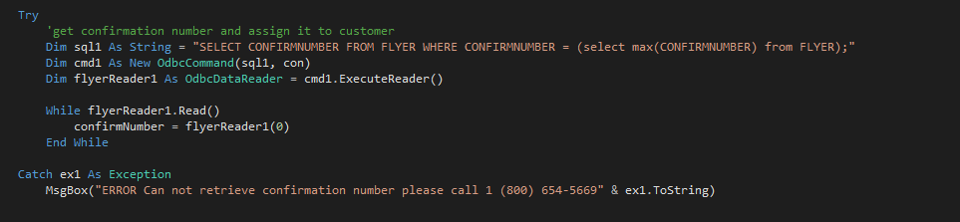

All Instances of Database Communication
Not in any particular order:

Slide 15
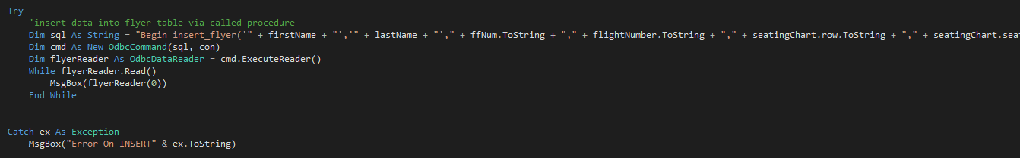
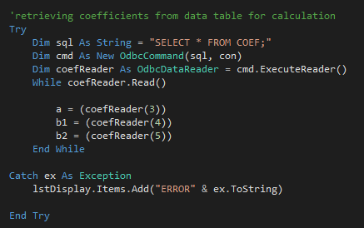
Communications, Continued

Slide 16
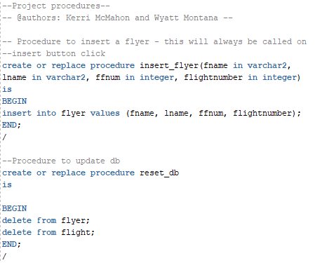

Some Server Side Code/Other Things Worth Noting

Slide 17
Challenges:
Our price data was in clusters, so our normal curve is not very visually pleasing or easy to work with graphically
Getting access to machines on campus with Visual Studio and working database connections was difficult and rare
Testing our program with real-life data was difficult. Our flight, 205, is not offered at all in 2020 until March 19, and all December dates starting the 22nd in 2019 are influenced by the holiday season. We were only able to legitimately test our prices with the website itself with very specific conditions. Limits our data comparisons.
Data visualization (tough for three dimensional data, let alone more than that), we had to outsource from Excel to get proper visuals
Comparing real time data on Alaska Air site to our linear regression prediction calculation was hard to compare since we are around the holidays and this will spike prices, and seats are already actively booked whereas our data starts with an empty flight

Slide 18
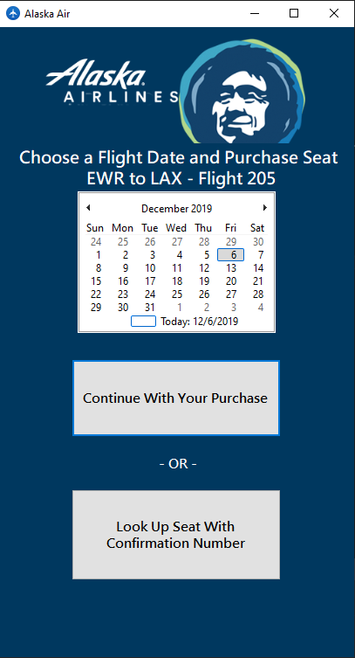
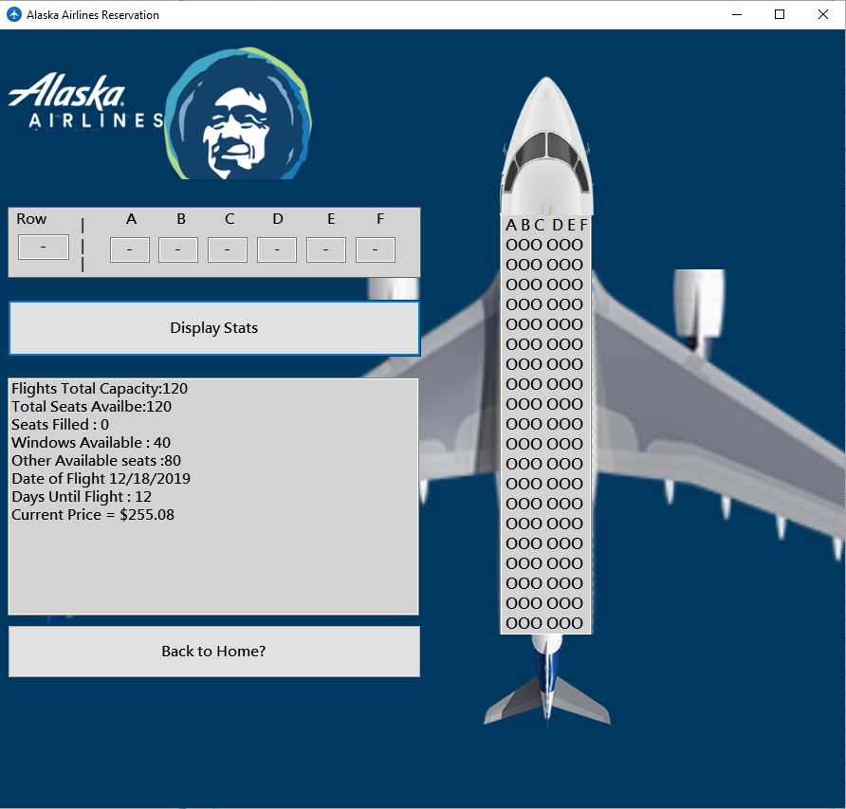
Functionality
Demo??
Demo?

Slide 19
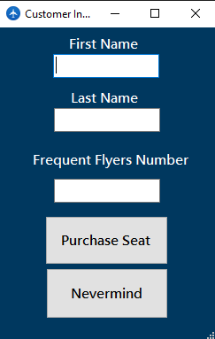
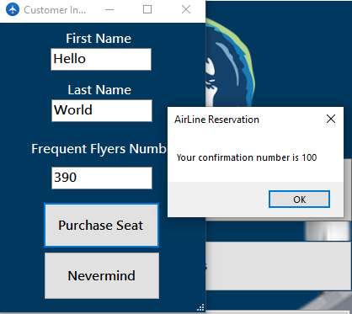
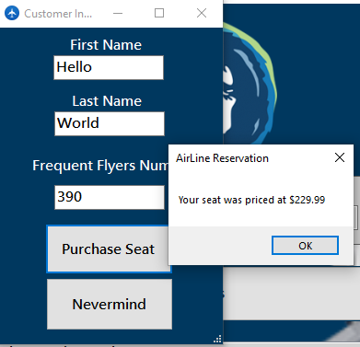

Slide 20
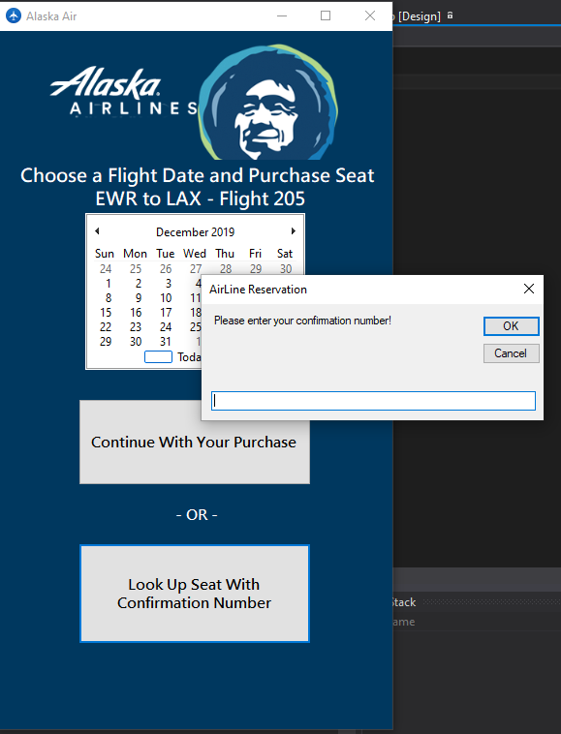
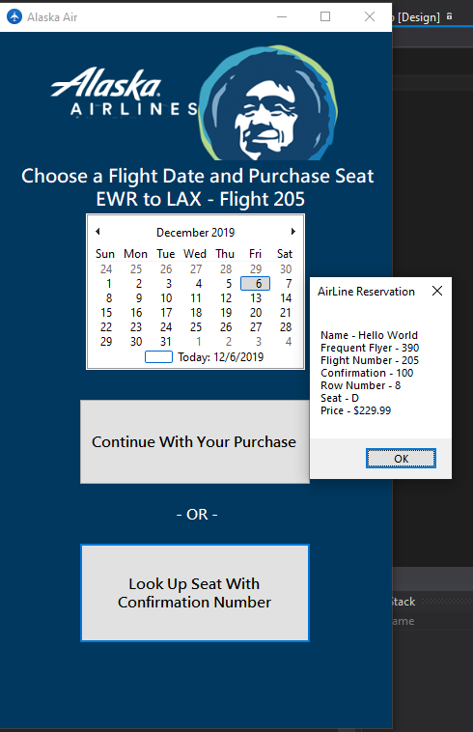

Slide 21
References
Marco Alderighi, A. A. (2017). The hidden sides of ‘dynamic pricing’ for airline tickets .
Michael D. Wittman, P. P. (2019). Dynamic pricing mechanisms for the airline industry:. J Revenue Pricing Manag, 100-106.
Oren Etzioni, C. A. (2019). To Buy or Not to Buy: Mining Airfare Data to Minimize.

Slide 22
SET SERVEROUTPUT ON;
DBMS_OUTPUT.PUT_LINE(‘ Thank you :-) ’);

